Slide 1
The Open Systems Interconnection Model (OSI)
The OSI Model: Understanding the Seven Layers of Computer Networks

Slide 2
OSI MODEL
OSI model was developed by the International Standard organization (ISO) in 1984, and it is now considered as an architectural model for the inter-computer communications regardless of their architecture.
OSI stands for Open System Interconnection is a reference model that describes how information from a software application in one computer moves through a physical medium to the software application in another computer.
OSI consists of seven layers, and each layer performs a particular network function.
OSI model divides the whole task into seven smaller and manageable tasks. Each layer is assigned a particular task.
Each layer is self-contained, so that task assigned to each layer can be performed independently.
Notes:
The purpose of OSI Model is to show how to facilitate communication between different systems without requiring changes to the logic of the underlying hardware and Software.

Slide 3
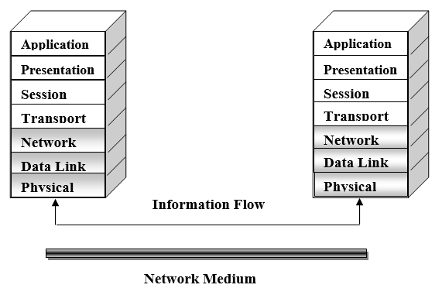
OSI Model

Slide 4
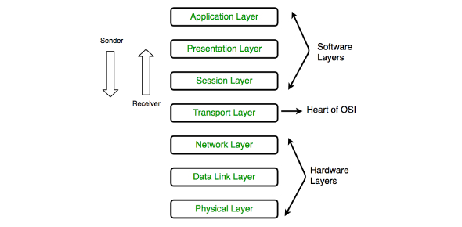
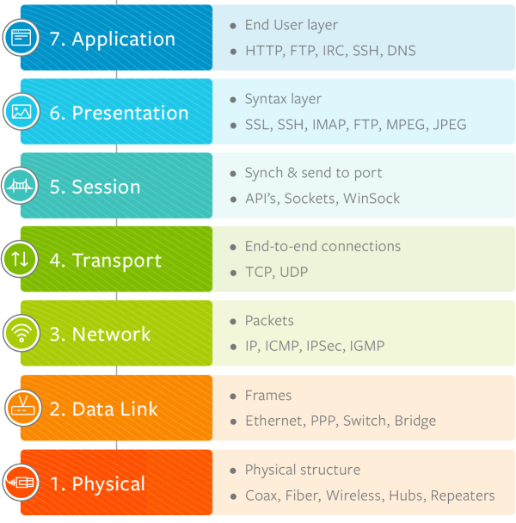

Slide 5
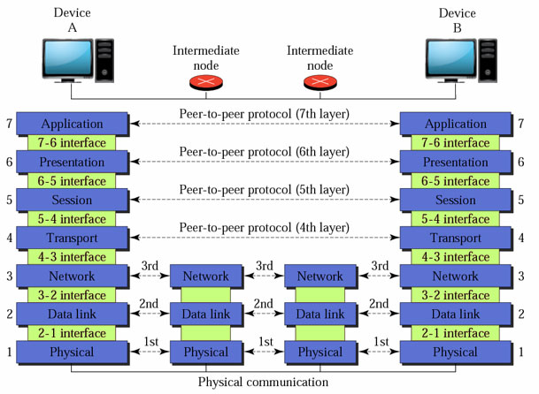

Slide 6
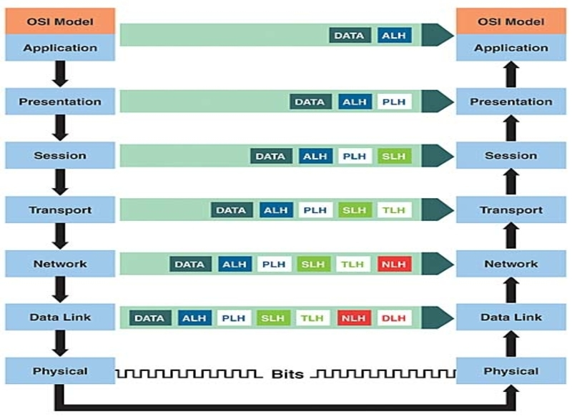

Slide 7
OSI Model
The OSI model attempts to define rules that apply to the following issues:
How network devices contact each other and, if they have different languages, how they communicate with each other.
Methods by which a device on a network knows when to transmit data and when not to.
How the physical transmission media are arranged and connected.
How to ensure that network devices maintain a proper rate of data flow.
How bits are represented on the network media.
Application
Presentation
Session
Transport
Network
Data Link
Physical

Slide 8
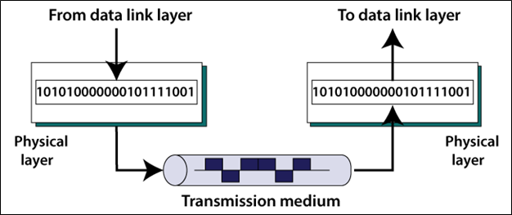
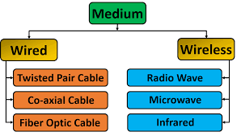
(1) Physical Layer
The physical layer is responsible for transmitting and receiving data over transmission medium. It define the Characteristics of the interface between device and the transmission medium.

Slide 9
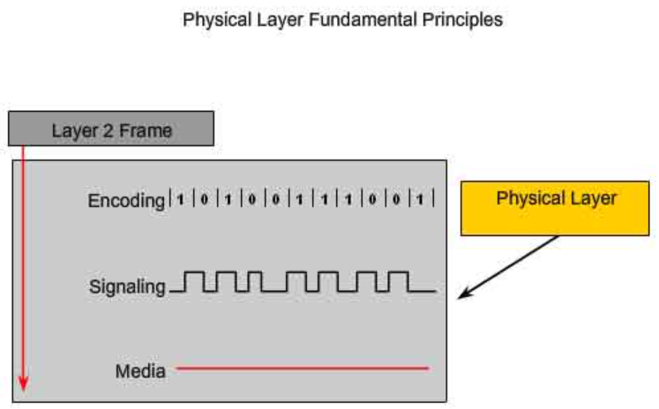
Representation of Bits: The physical layer data consists of stream of bits with no interpretation. To be transmitted, bits must be encoded into signals to electrical or optical.
Encoding is a method of converting stream of databits into predefined code
The method of representing the bits is called signaling method

Slide 10
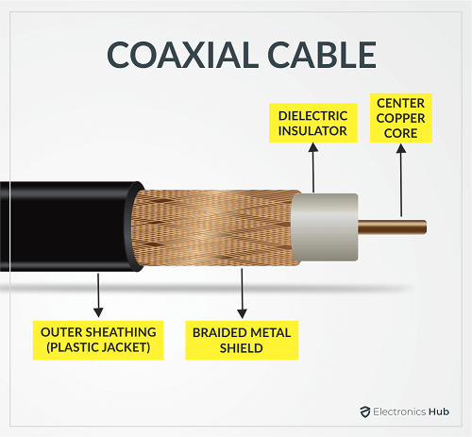
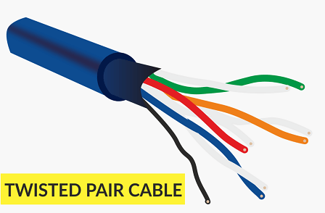
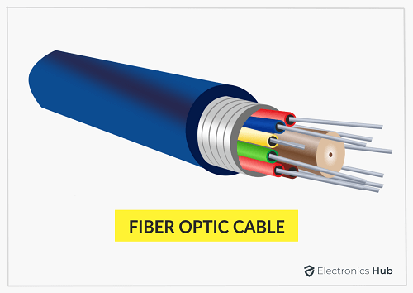
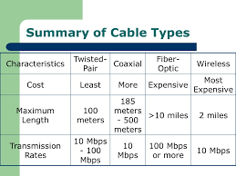
Data Rate: The transmission rate- the number of bits sent each second is also defined by physical layer.

Slide 11
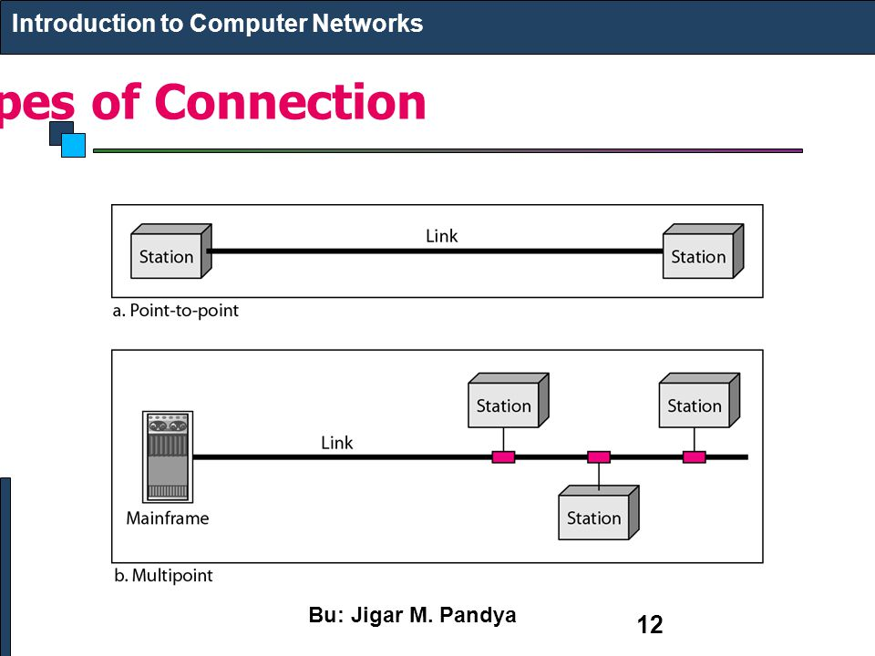
Line Configuration: The physical layer is concerned with the connection of devices to the media

Slide 12
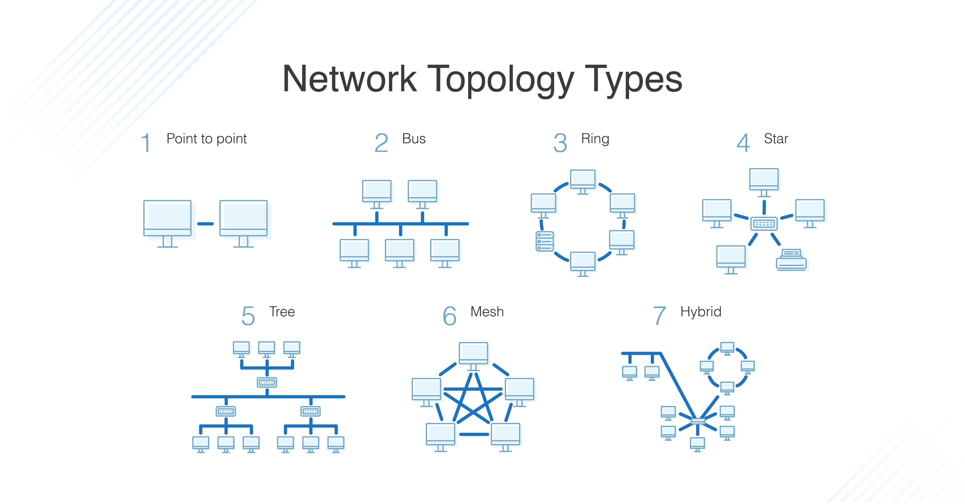
Physical Topology: The physical topology defines how devices connect to make network

Slide 13
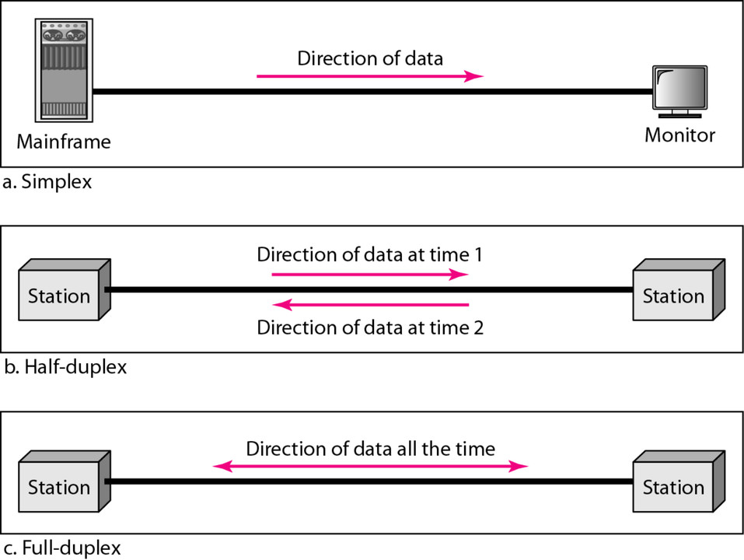
Transmission Mode: The physical layer also define the direction of transmission between two devices

Slide 14
Function of Physical Layer
The following items are addressed at the physical layer:
Physical Characteristics of Interfaces and Media:
It defines the electrical and mechanical characteristics of the interface and the media.
It defines the types of transmission medium.
Representation of Bits
To transmit the streams of bits they must be encoded into signal.
It defines the type of encoding whether electrical or optical.
Data rate
It defines the transmission rate, i.e., the number of bits sent per second.
Synchronization of Bits
The sender and receiver must be synchronized at bit level.
Line Configuration
It defines the type of connection between the devices • Two types of connection are : Point-to-Point; Multipoint
Physical Topology
The sender and receiver must be synchronized at bit level.
Transmission Mode
The physical layer also defines the direction of transmission between two devices: Simplex, Half-duplex, Full-duplex.

Slide 15
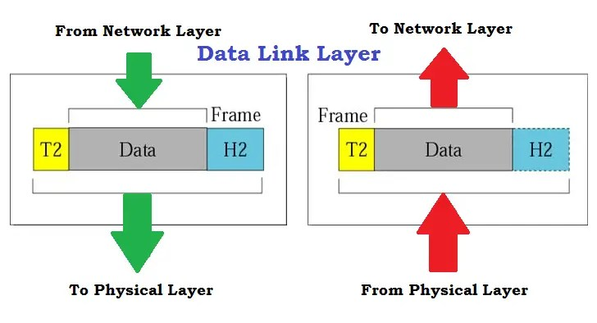
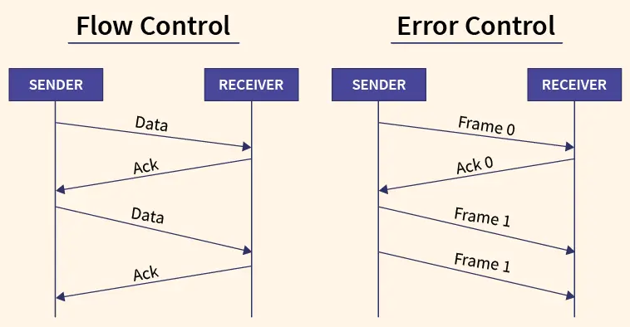
(2) Data Link Layer
Framing: The data link layer is responsible to divide the stream of bits received from network layer into manageable data units called frames.
Physical Addressing: It adds a header to the frame to define the sender and receiver of the frame.
Flow Control: The data link layer imposes a flow control mechanism to avoid overwhelming the receiver.

Slide 16
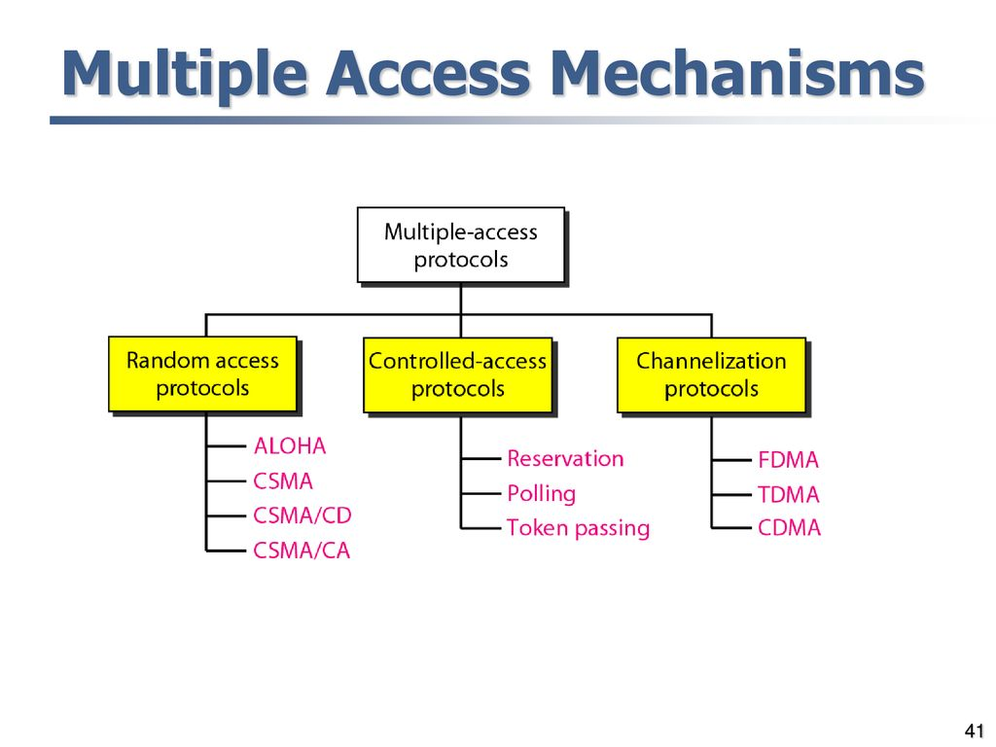
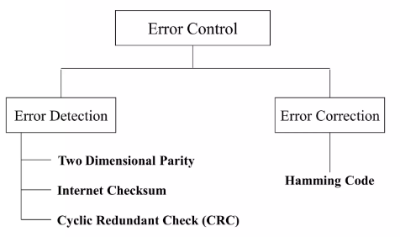
(2) Data Link Layer
Error Control: It adds reliability by adding mechanisms to detect and retransmit damaged or lost frames. It also uses a mechanism to recognize duplicate frames by adding the trailer to the end of the frame
Access Control: It determines which device has control over the link at any given time when two or more devices are connected to the same link.

Slide 17
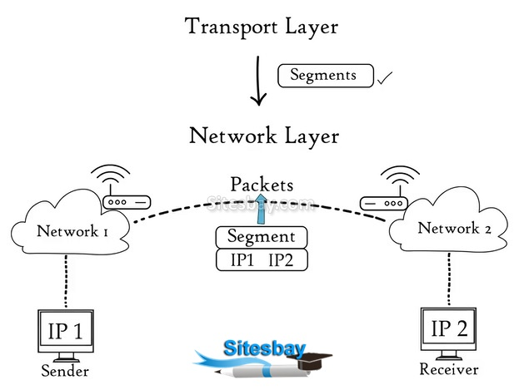
Application
(3) Network Layer
Presentation
The network layer is responsible for the source to destination delivery of packet, possibly across multiple networks (links).
Logical Addressing: When a packet passes the network boundary, the network layer adds the logical addresses of the sender and receiver.
IP addresses are Logical addresses (not physical)
Every host have unique IP address
Routing: When independent networks or links are connected to create internetworks, the connecting devices (called routers or switches) route or switch the packets to their final destination.
Session
Transport
Network
Data Link
Physical

Slide 18
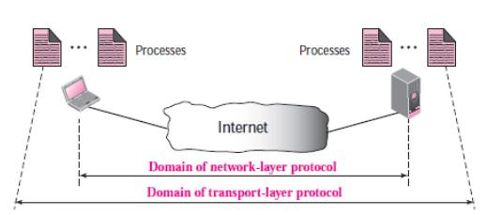
(4) Transport Layer
The transport layer header must include a type of address called a service-point address (or port address). The network layer gets each packet to the correct computer; the transport layer gets the entire message to the correct process on that computer.

Slide 19
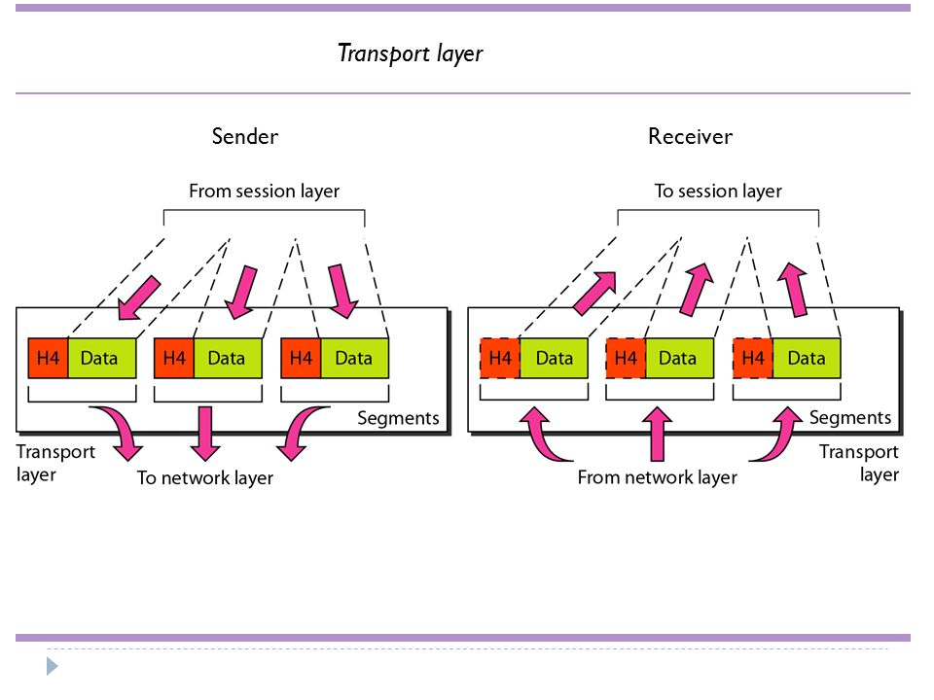
Segmentation and reassembly: A message is divided into transmittable segments, with each segment containing a sequence number. These numbers are used to reassemble the message at the destination and to identify and replace packets that were lost in transmission.
Flow Control: Flow control is performed from end to end rather than across a single link.
Error Control: At this layer, the error control is performed in a process-to-process rather than across a single link.

Slide 20
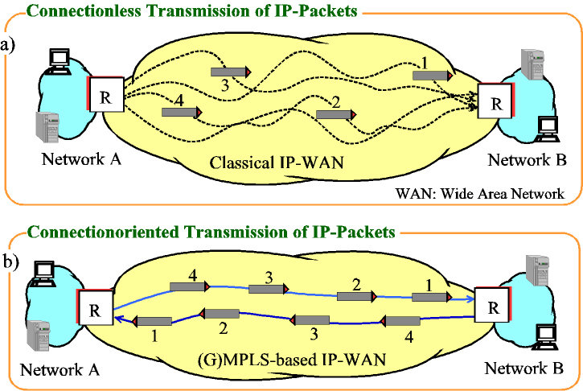
Connection Control: The transport layer can be either connectionless or connection oriented. A connectionless transport layer treats each segment as an independent packet and delivers it to the transport layer at the destination machine. A connection oriented makes a connection with the transport layer at the destination machine first before delivering the packets. After all the data are transferred, the connection is terminated.

Slide 21
Transport Layer (summary)
Some of the functions offered by the transport layer include:
Application identification
Client-side entity identification
Confirmation that the entire message arrived intact
Segmentation of data for network transport
Control of data flow to prevent memory overruns
Establishment and maintenance of both ends of virtual circuits
Transmission-error detection
Multiplexing or sharing of multiple sessions over a single physical link
Application
Presentation
Session
Transport
Network
Data Link
Physical

Slide 22
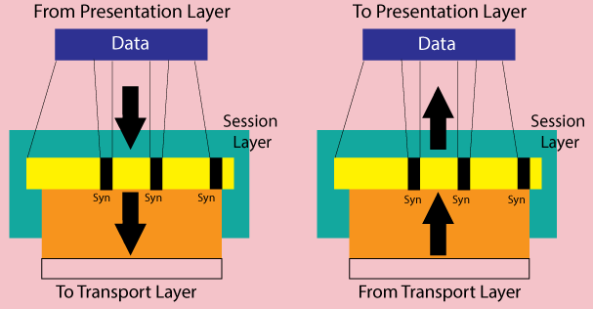
Responsibilities Of Session Layer
Dialog Control: The session layer allows two systems to enter into a dialog. It allows the communication between two processes to take place in either half-duplex or full- duplex mode.
Synchronization: The session layer allows a process to add checkpoints, or synchronization points, to a stream of data. • E.g. If a system is sending a file of 100 pages, it is advisable to insert checkpoints after every 10 pages to ensure that each 10- page unit is received and acknowledged independently. In this case, if a crash happens during the transmission of page 23, the only pages that need to be resent after system recovery are pages 21 to 30.

Slide 23
(5) Session Layer
Session layer functionality includes:
Virtual connection between application entities
Synchronization of data flow
Creation of dialog units
Partitioning of services into functional groups
Acknowledgements of data received during a session
Retransmission of data if it is not received by a device
Application
Presentation
Session
Transport
Network
Data Link
Physical

Slide 24
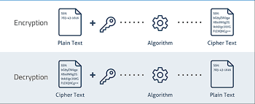
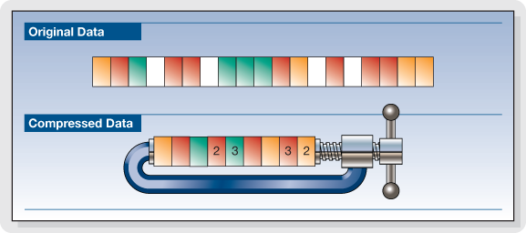
Responsibilities of Presentation Layer
The presentation layer is responsible for translation, compression, and encryption.
Translation: Presentation layer is responsible for the interoperability between different encoding methods.
Encryption: To carry sensitive information, a system must be able to ensure privacy. Encryption means that the sender transforms the original information to another form and send the resulting message out over the network. Decryption reverses the original process to transform the message back to its original form.
Compression: Data compression reduces the number of bits contained in the information. Data compression is important in the transmission of multimedia such as text, audio and video.

Slide 25
(6) Presentation Layer
The following items are addressed at the presentation layer:
Encryption and decryption of a message for security
Compression and expansion of a message so that it travels efficiently
Graphics formatting
Content translation
System-specific translation
Application
Presentation
Session
Transport
Network
Data Link
Physical

Slide 26
Application Layer
Application Layer: is responsible for providing services to the user.
Network Virtual Terminal: is a software version of a physical terminal and it allows a user to log on to a remote host.
File transfer, access, and management: The application allows a user to access files in a remote host, to retrieve files from a remote computer for use in the local computer, and to manage or control files in a remote computer locally.
Mail Services: This application provides the basis for e-mail forwarding and storage.
Directory Services: This application provides distributed sources and access for global information about various objects and services.

Slide 27
(7) Application Layer
database access
e-mail
support for file transfers
ability to print on a network
browsing the World Wide Web
Application
Presentation
Session
Transport
Network
Data Link
Physical

Slide 28
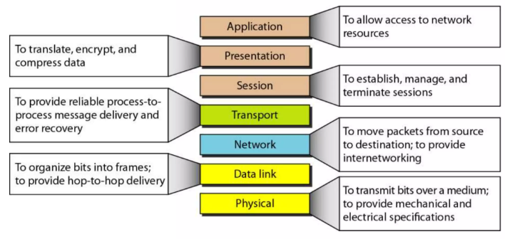
Summary of OSI Model

Slide 29
Thank You
Q & A

